Slide 1
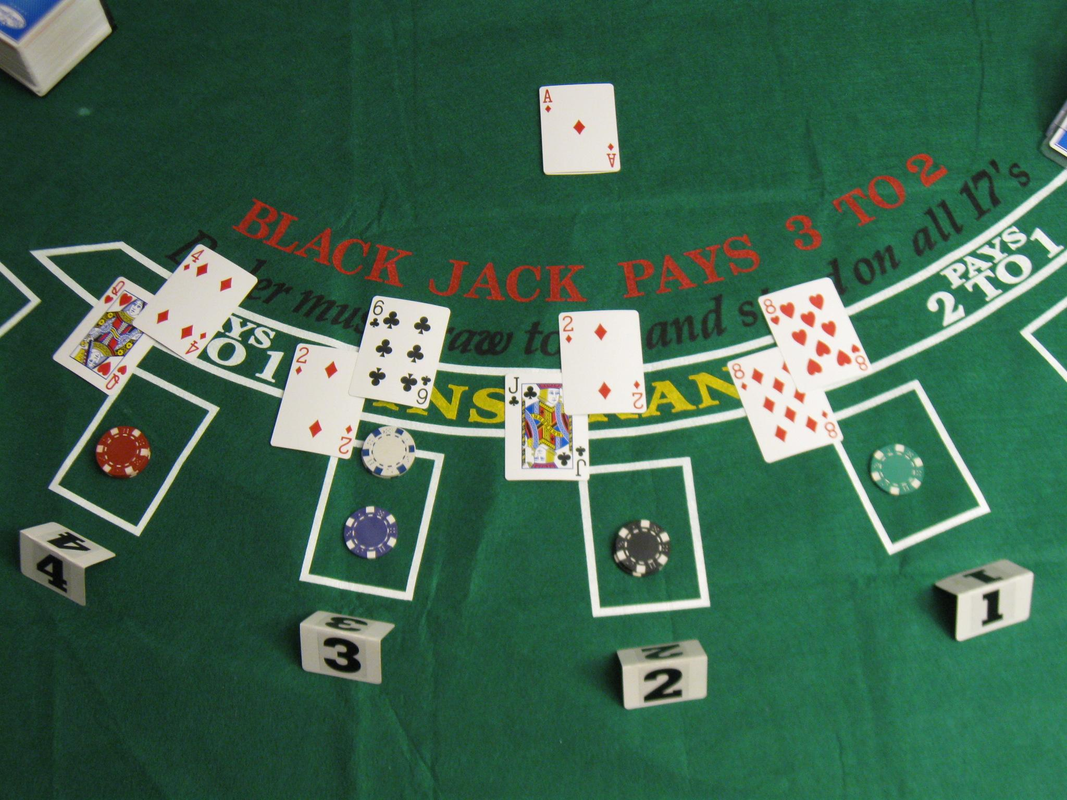
BLACKJACK MINIMUM RISK ALGORITHM
AKSHAY RAJ. S
(180001058)
PRASHANT KUMAR RAJAK
(180001037)

Slide 2
RULES OF BLACKJACK
Blackjack refers to magic number 21.
The goal of blackjack is to beat the dealer's hand without going over 21.
Face cards are worth 10. Aces are worth 1 or 11, whichever makes a better hand.
Each player starts with two cards, one of the dealer's cards is hidden until the end.
If you go over 21 you bust, and the dealer wins regardless of the dealer's hand.
If you are dealt 21 from the start (Ace & 10), you got a blackjack.
Dealer will hit until his/her cards total 17 or higher.

Slide 3
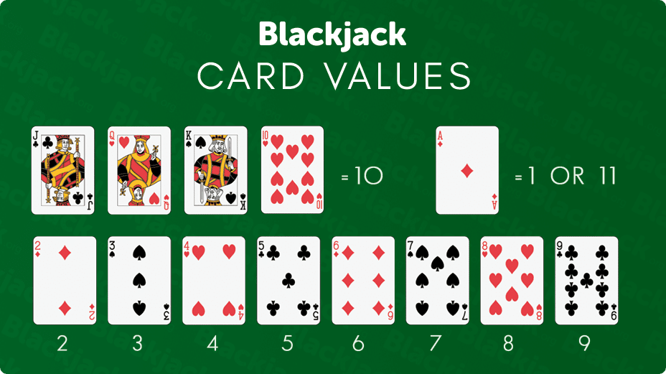

Slide 4
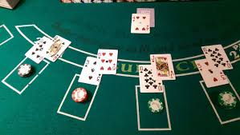
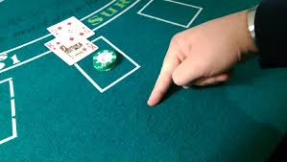
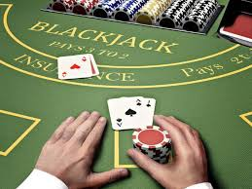
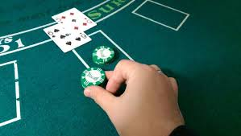
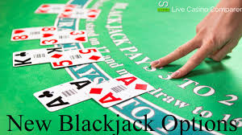
SYMBOLS

Slide 5
MOVES ALLOWED
HIT
Player draws a card from the deck. If the player is not busted he can again hit, stay or double down in the next move.
STAY
In this move, the player does nothing and waits for the dealer to gets busted or his total is sufficient to beat the dealer.

Slide 6
MOVES ALLOWED
Double Down
The player is confident about the next hit and he doubles the bet. After doubling down, the player is allowed to draw only one card.
SPLIT
When the player is dealt with same value cards he has an option to split his hand into two. Then he has to bet on both of his hands.

Slide 7
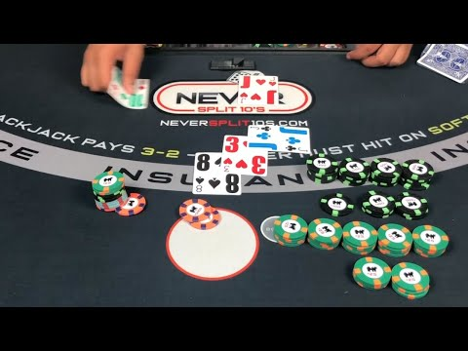

Slide 8
HISTORY OF BLACKJACK
In 1956, THORP WITH HIS THREE COLLEAGUES, PUBLISHED THE OPTIMUM STRATEGY, BY EMPIRICAL TRIALS
IN 1962, MATHEMATICS PROFESSOR, DR, EDWARD THORP WROTE BOOK “BEAT THE DEALER”.
AFTER BASIC STRATEGY, EVOLUTIONARY ALGORITHM WAS DEVELOPED WITH 3 MILLION SIMULATIONS
THEN EVOLVED BASIC STRATEGY WAS INTRODUCED THAT OFFERED ADVANTAGE OF +0.218% TO PLAYER
THEN COUNTING CARDS STRATEGY WAS INTRODUCED WHICH GIVES THE HIGHEST CHANCE TO WIN MONEY
THE BASIC STRATEGY FOCUSES ON
TO MAXIMIZE PROFIT ON CONSISTENT HANDS
TO MINIMIZE LOSS IN THE LONG TERM

Slide 9
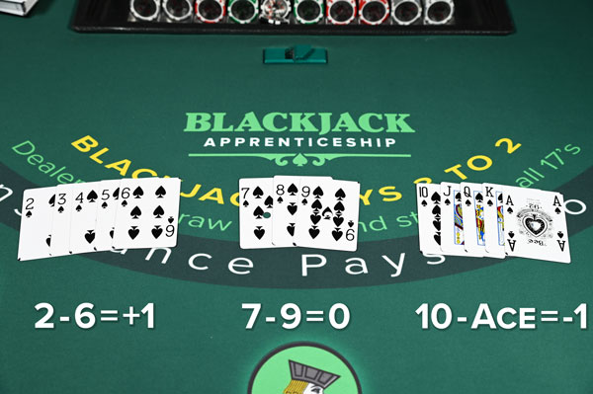
COUNTING CARDS:

Slide 10
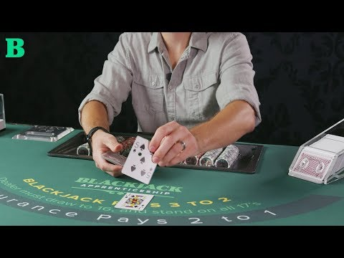
EXAMPLE OF COUNTING CARDS:

Slide 11
TRUE COUNT:
TRUE COUNT = RUNNING COUNT / REMAINING NUMBER OF DECK OF CARDS
THIS TRUE COUNT HELPS TO MAKE A DECISION AS IT GIVES AN IDEA OF WHAT TYPE OF CARDS ARE GOING TO BE DEALT NEXT.

Slide 12
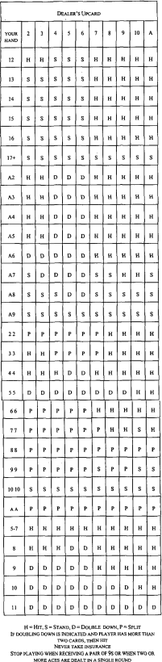
EVOLVED BASIC STRATEGY :

Slide 13
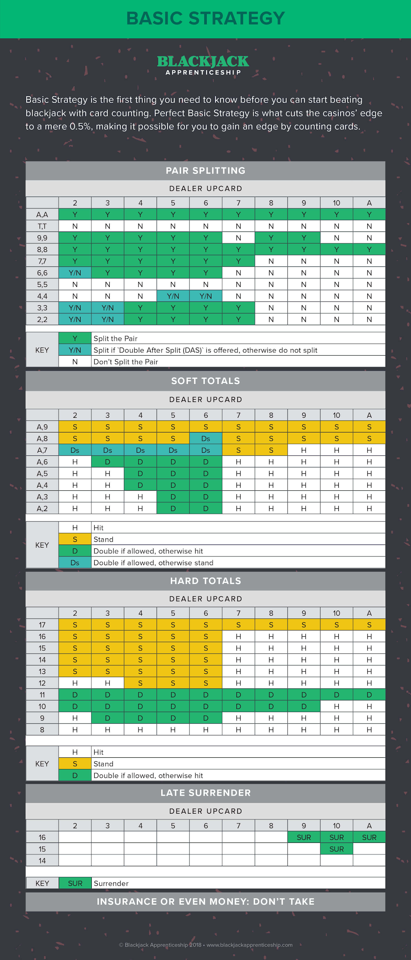

Slide 16
Complexity Analysis
Time complexity of the program is O(n²).
Where n is the number of players.

Slide 17
Execution time of the play() function
For n=1 players, t=5.00 sec.
For n=2 players, t=20.00 sec.

Slide 18
References
https://ieeexplore.ieee.org/document/1331064
Author - D.B. Fogel
https://ieeexplore.ieee.org/document/1299399
Author - G. Kendall & C. Smith
http://www.cplusplus.com/ (for pre-defined function used in the implementation).

Slide 19
THANK YOU
Prashant Kumar Rajak Suryapogu Akshay Raj
(180001037) (180001058)

